Slide 1

Face Mask Detection using TensorFlow
Sai Vikas Devisetty
Suhasini Konimeti Naresh Kumar

Slide 2
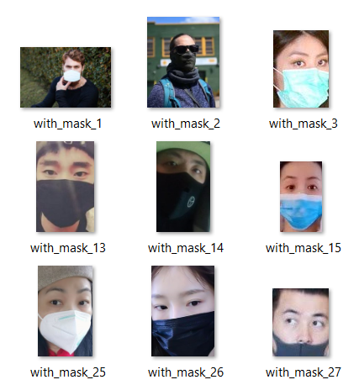
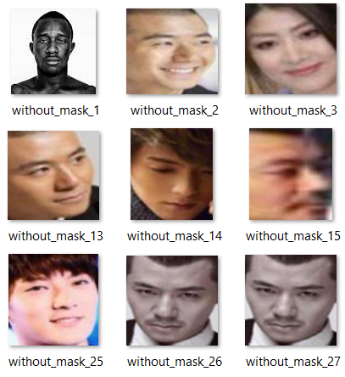
Data Collection
The dataset consists of 1376 images
690 face images with mask
686 face images with out masks

Slide 3
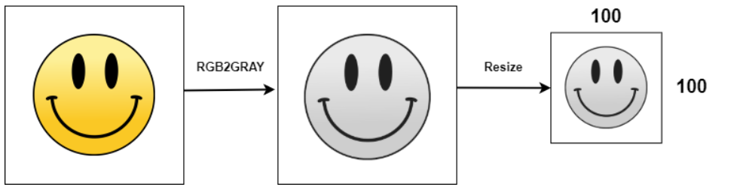
Data Preprocessing
The images in the dataset are converted into gray scale. In this case, converting a colored image to a grayscale image will not matter, because eventually the model will be learning from the geometry present in the image. The image-binarization will help in sharpening the image by identifying the light and dark areas.
Then the images are resized. Principally, our machine learning models train faster on smaller images. Moreover, many deep learning model architectures require that our images are of the same size and our raw collected images may vary in size

Slide 4
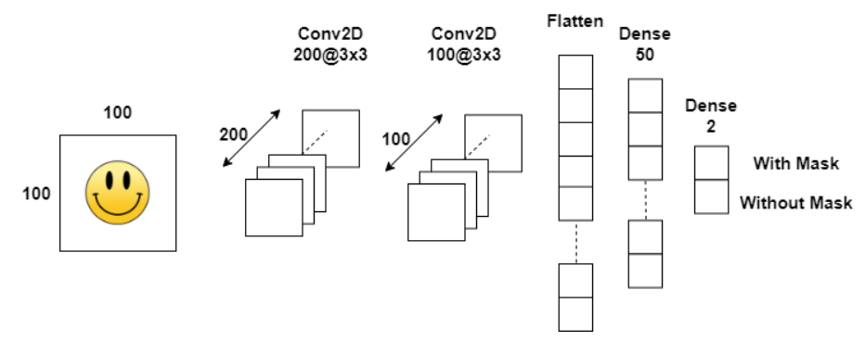
Convolutional Neural Network Architecture
The Sequential model is a linear stack of layers. The common architecture of ConvNets is a sequential architecture. Sequential is the easiest way to build a model in Keras. It allows you to build a model layer by layer. Each layer has weights that correspond to the layer the follows it. We use the 'add()' function to add layers to our model.
conv2d(), the TensorFlow function is used to build a 2D convolutional layer as part of our CNN architecture

Slide 5
Convolutional Neural Network Architecture
The Max pooling operation for 2D spatial data down samples the input representation by taking the maximum value over the window defined by pool size for each dimension along the feature's axis. The window is shifted by strides in each dimension.
The role of the Flatten layer in Keras is super simple: A flatten operation on a tensor reshapes the tensor to have the shape that is equal to the number of elements contained in tensor non including the batch dimension.

Slide 6
Convolutional Neural Network Architecture
The rectifier is the most popular activation function for deep neural networks. A unit employing the rectifier is also called a rectified linear unit (ReLU). Rectified linear units find applications in computer vision and speech recognition using deep neural nets and computational neuroscience.
Softmax converts a real vector to a vector of categorical probabilities. The elements of the output vector are in range (0, 1) and sum to 1. Softmax is often used as the activation for the last layer of a classification network because the result could be interpreted as a probability distribution

Slide 7
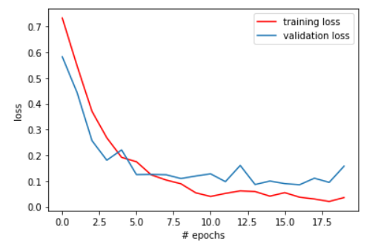
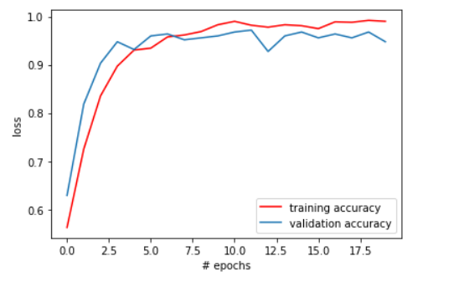
Model Construction and Evaluation
Model is trained on 990 samples and validated on 248 samples
20 epochs are run and only the best model with the lowest validation loss is saved and used
Model has the lowest validation loss in epoch 17 and it is used for the detection of masks in the next step

Slide 8
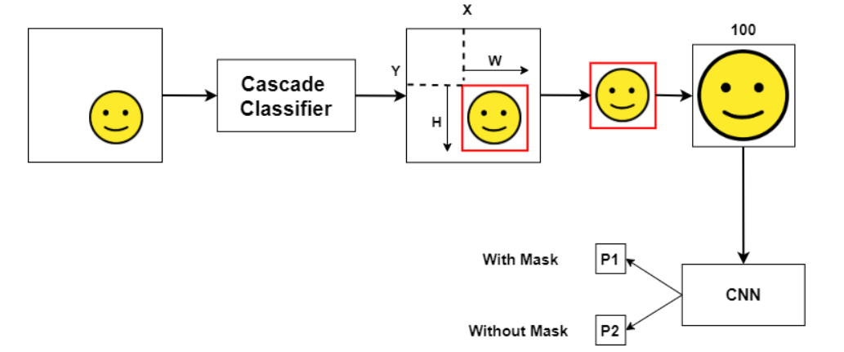
Mask Detection
We used the Cascade Classifier class to detect objects in a video stream. Particularly, we used the functions cv::CascadeClassifier::load to load a . xml classifier file. Haarcascade frontal face classifier is used since it is an effective object detection approach for faces in a video stream
The image is converted into gray scale and resized after passing through the classifier before sent to the model for detection of face mask

Slide 9
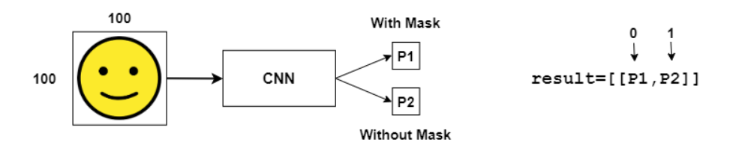
Mask Detection
OpenCV is used for video streaming of the input, resizing and labelling the output
OpenCV (Open-Source Computer Vision Library) is an open-source computer vision and machine learning software library. OpenCV was built to provide a common infrastructure for computer vision applications and to accelerate the use of machine perception in the commercial products.

Slide 10
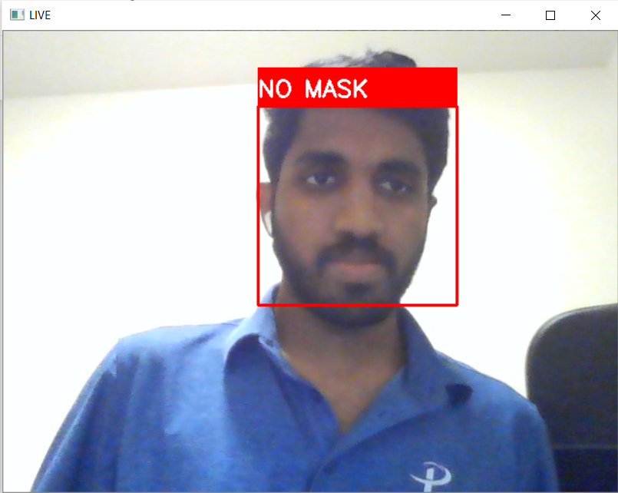

Face Mask Detection

Slide 11
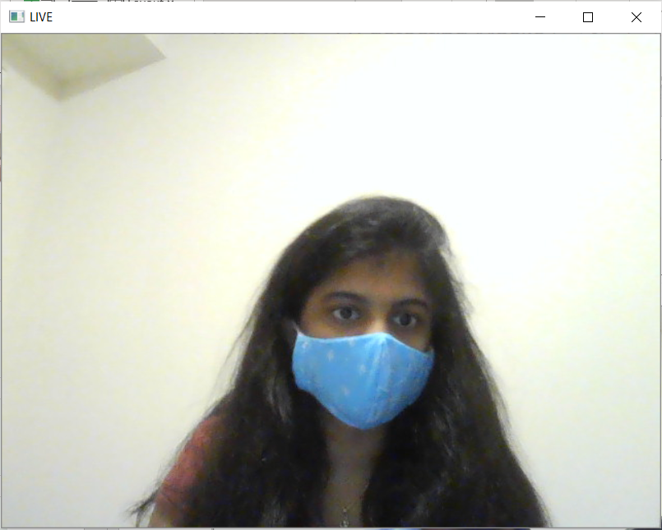
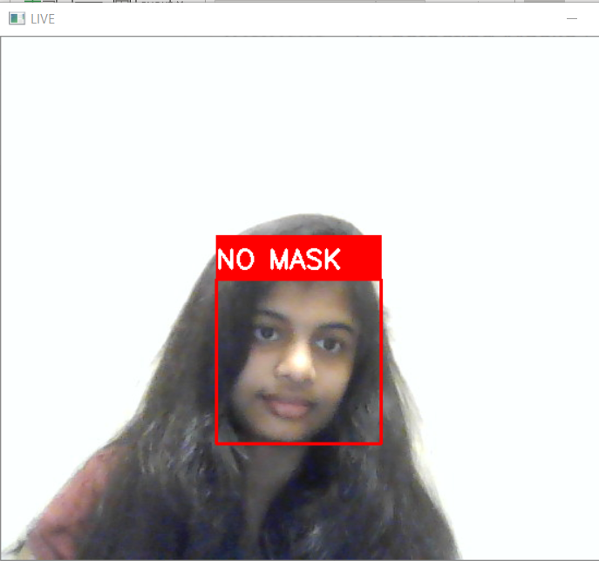
Face Mask Detection

Slide 12
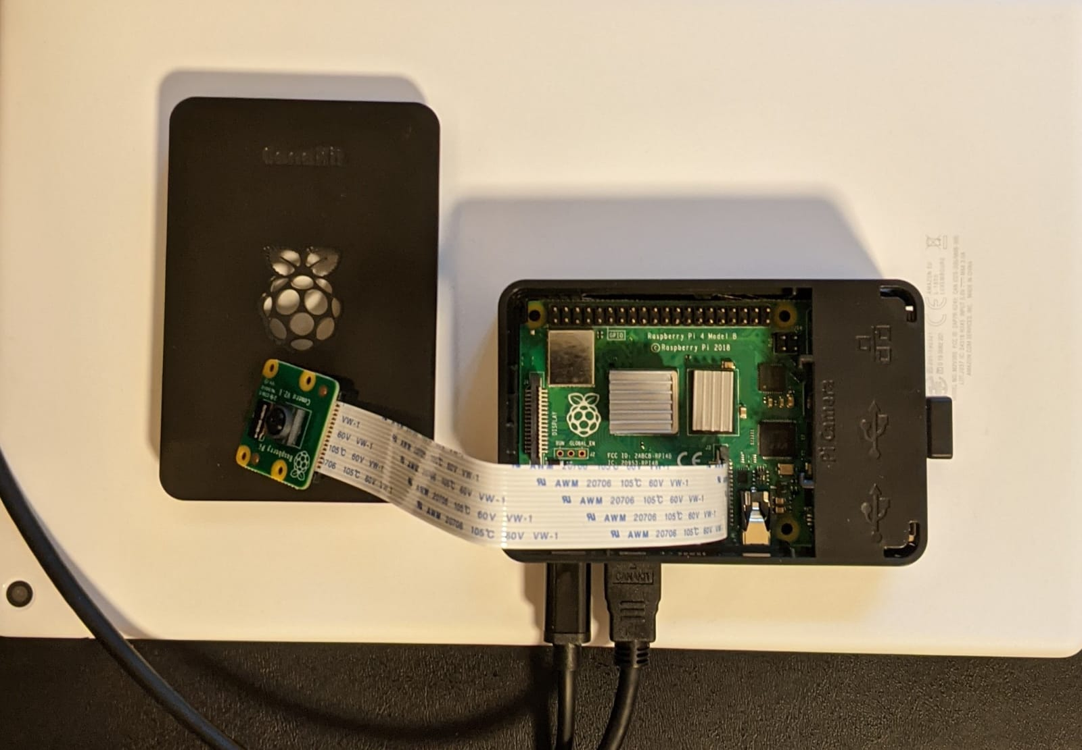
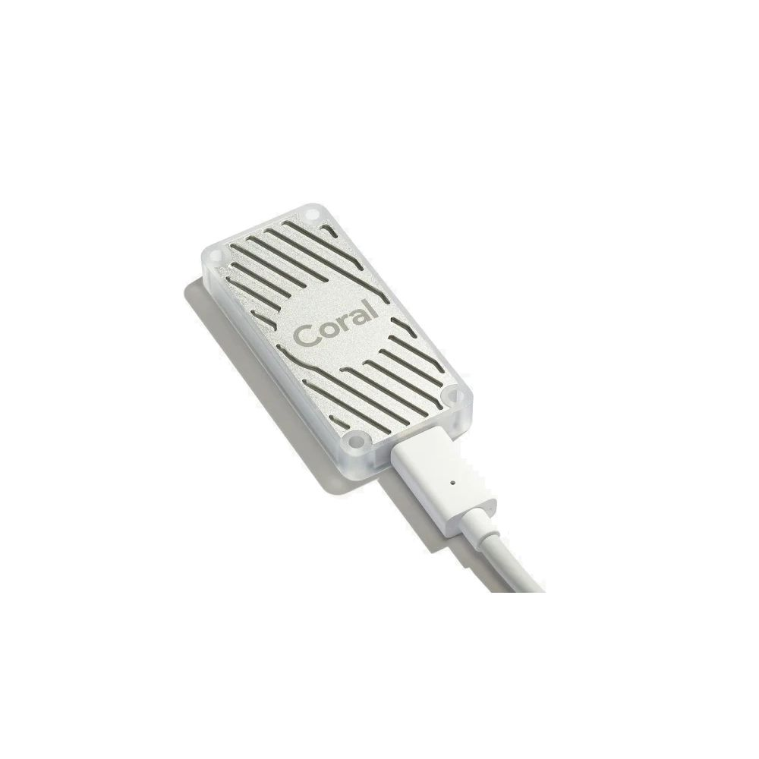
Deploying to Raspberry pi 4
We are planning to deploy the model to raspberry pi 4 and detect the input using Pi Camera V2.
Since our model is developed using TensorFlow 2.3, we need an edge TPU to deploy the model along with Raspberry Pi
Google Coral is the best compatible edge TPU available in the market

Slide 13
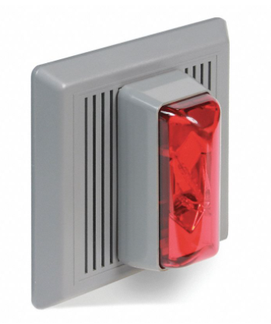
Future work
A buzzer can be integrated with the system so that when a person is detected with out a mask, it gives an alarm so that people around the person can maintain social distance with him and the management of the organization can take necessary actions
If a person within the organization is not wearing a mask, he can be notified with a mail/ message to his cell phone using face detection algorithms deployed along with the mask detection model

Slide 14
Conclusion
This work is motivated from the Object Detection model developed by TensorFlow
TensorFlow lite with Coral edge TPU can be much more effective for this work
When associated with cloud technologies like AWS, entire model construction, evaluation and deployment can be done using AWS Deep Learning AMIs

Slide 15

Questions

Slide 16

Thank you

